Slide 1
Amazon sales analysis
By- Lalasab Allasab Nadaf

Slide 2
Objective:
Survival of any firm depends on its profits and costs involved in running a firm. Sales management in the E-commerce business is very crucial for smooth functioning and development of firms. There fore sales management is most important function of commercial as well as business enterprises.
In this project:
Do ETL : Extract-Transform-Load the Amazon sales dataset and find the
Sales-trend -> month wise , year wise , yearly_month wise
Benefits of project:
Analysis of trend of the sales .
Effect of cost and sales on profit
Design the amazing dashboard on Powerbi.

Slide 3
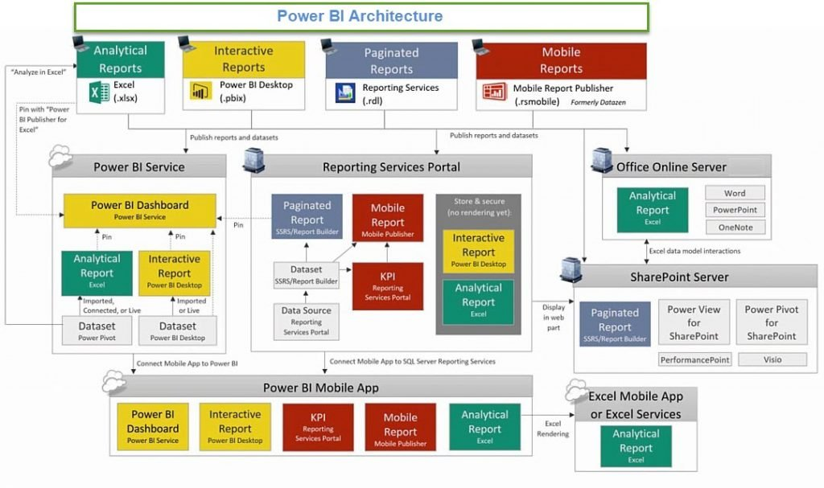
Architecture

Slide 4
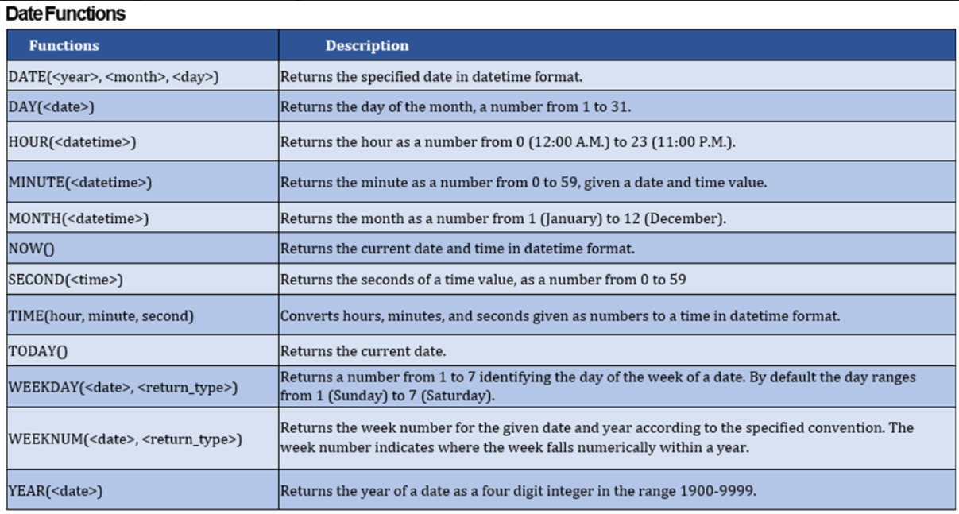
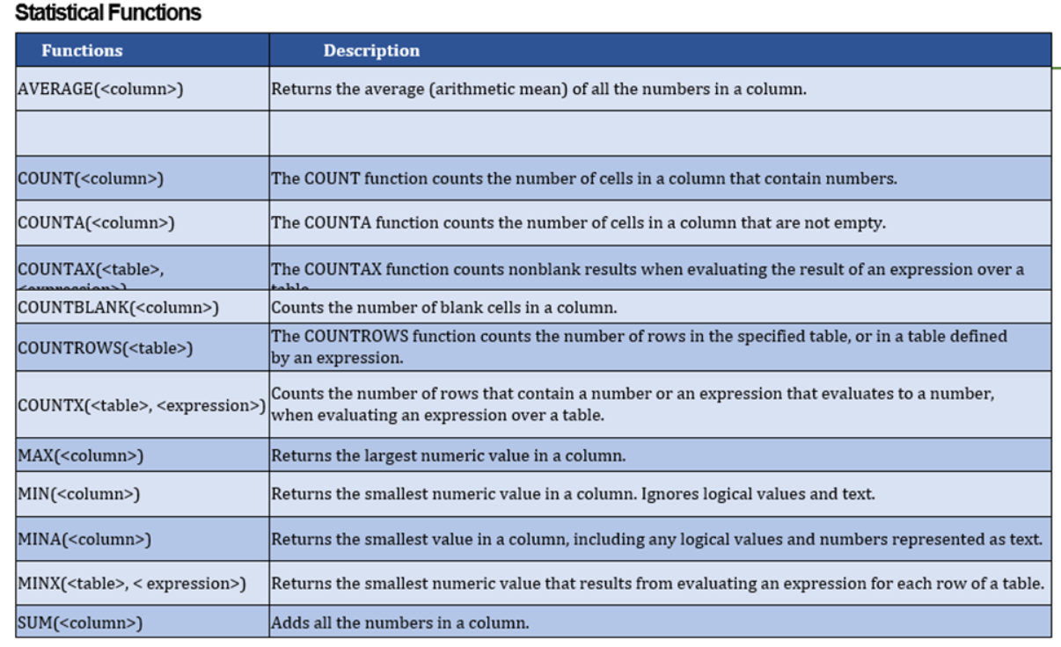
Understanding DAX Functions and creating measures-

Slide 5
Different ways to visualize data in Power BI
Power BI comes with several visuals, including pie charts, maps, and bar charts. It also includes complicated models such as funnels, gauge charts, a cascade, and a variety of other elements.
In this project I have used:
Donut chart
Clustered bar chart
Line graph
Clustered column chart
Slicers
Buttons
Matrix

Slide 6
Q & A:
1. What is Power BI?
Power BI is a business analytics tool developed by Microsoft that helps you turn multiple unrelated data sources into valuable and interactive insights. These data may be in the form of an Excel spreadsheet or cloud-based/on-premises hybrid data warehouses. You can easily connect to all your data sources and share the insights with anyone.
2. Why should we use Power BI?
Because Power BI provides an easy way for anyone, including non-technical people, to connect, change, and visualize their raw business data from many different sources and turn it into valuable data that makes it easy to make smart business decisions.

Slide 7

3. What is Power Pivot?
Power Pivot is an add-on provided by Microsoft for Excel since 2010. Power Pivot was designed to extend the analytical capabilities and services of Microsoft Excel.
4. What is Power Query?
Power Query is a business intelligence tool designed by Microsoft for Excel. Power Query allows you to import data from various data sources and will enable you to clean, transform and reshape your data as per the requirements. Power Query allows you to write your query once and then run it with a simple refresh.
5. What is DAX?
DAX stands for Data Analysis Expressions. It's a collection of functions, operators, and constants used in formulas to calculate and return values. In other words, it helps you create new info from data you already have.

Slide 8
6. What are Filters in Power BI?
The term "Filter" is self-explanatory. Filters are mathematical and logical conditions applied to data to filter out essential information in rows and columns. The following are the variety of filters available in Power BI:
Manual filters
Auto filters
Include/Exclude filters
Drill-down filters
Cross Drill filters
Drillthrough filters
Drillthrough filters
URL filters–transient
Pass-Through filters

Slide 9
7. What are Custom Visuals in Power BI?
Custom Visuals are like any other visualizations, generated using Power BI. The only difference is that it developes the custom visuals using a custom SDK. The languages like JQuery and JavaScript are used to create custom visuals in Power BI.
8. What is GetData in Power BI?
Get Data is a simple icon on Power BI used to import data from the source.
9. Mention some advantages of Power BI.
Some of the advantages of using Power BI:
It helps build an interactable data visualization in data centers
It allows users to transform data into visuals and share them with anyone
It establishes a connection for Excel queries and dashboards for fast analysis
It provides quick and accurate solutions
It enables users to perform queries on reports using simple English words

